Slide 1
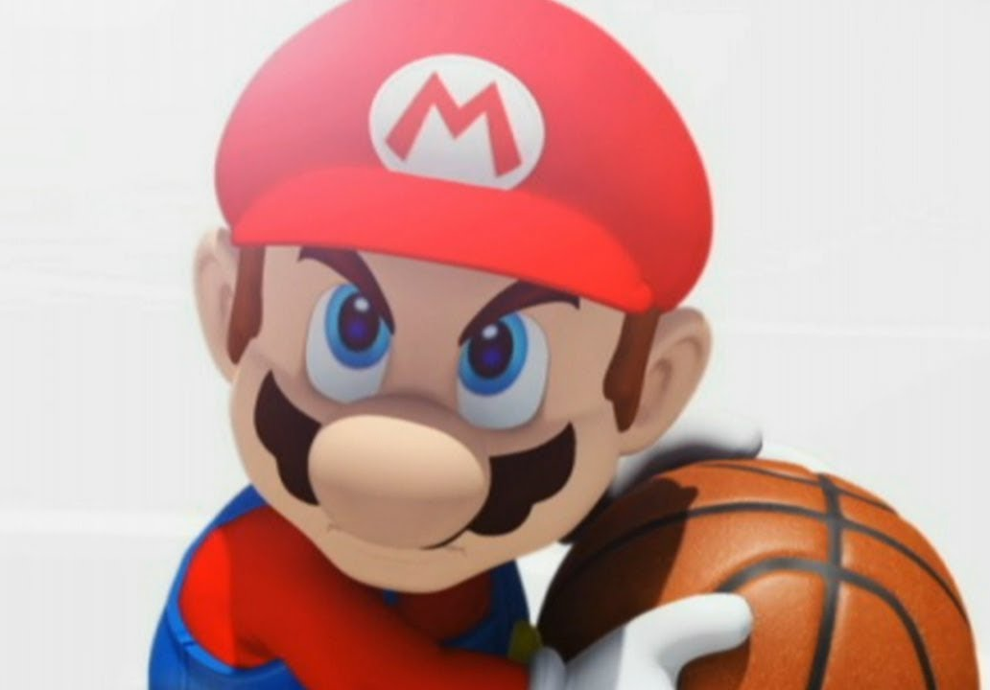

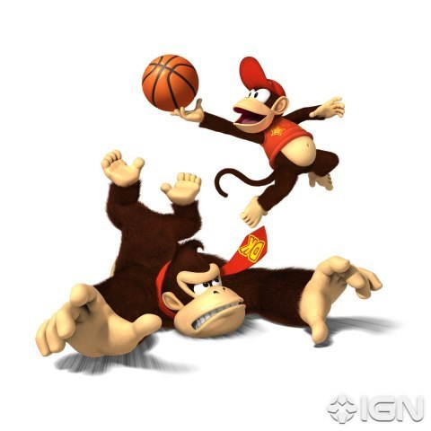
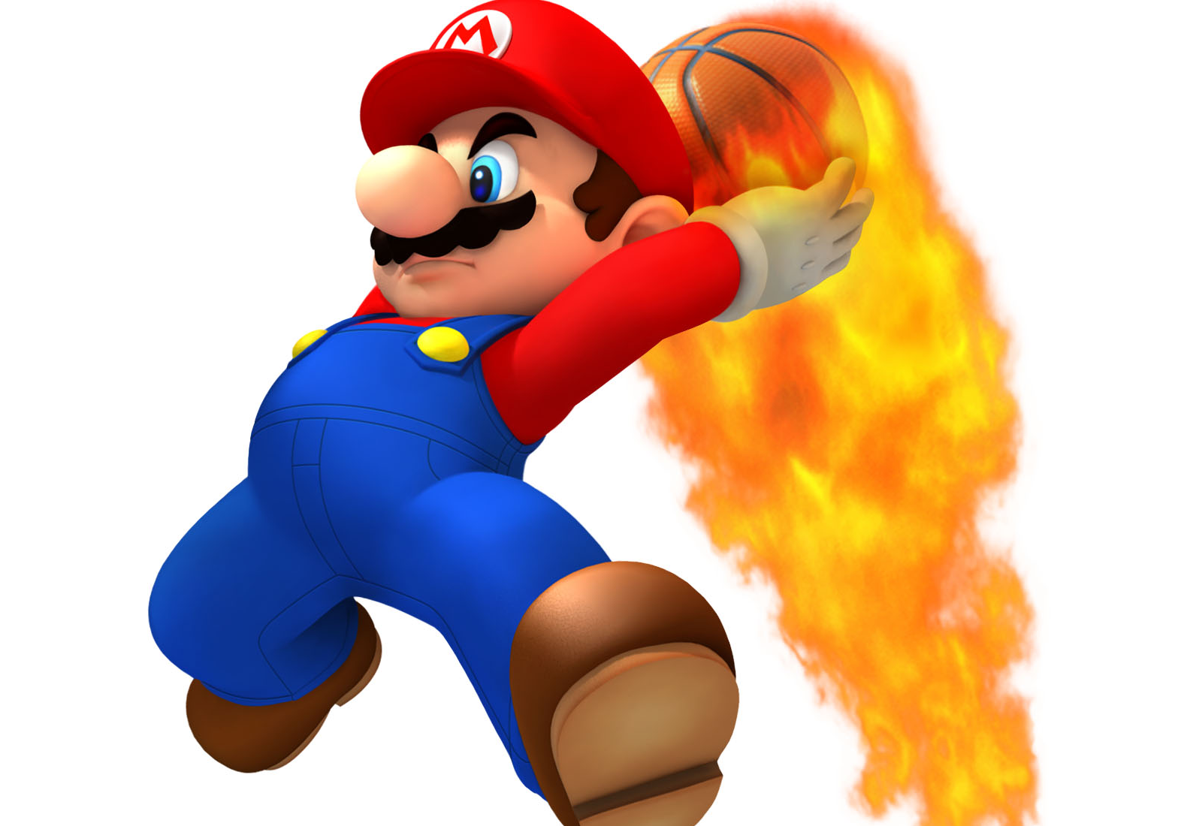
Basketball IV
Produced by Dr. Mario
UNC STOR 390

Slide 2
Team and Individual Matchups
Non-Transitivity of NBA Matchups

Slide 3
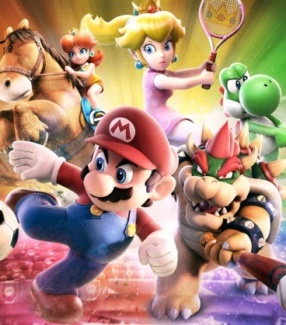
Final Inspiration
There is no “I” in team,
but there is in win.
- Michael Jordan

